Slide 1


Slide 2
WE INTRODUCE

Slide 3
ENERGIZE
Notes:
What is energize?

Slide 8
WIRELESS CHARGING
Notes:
Describe energize

Slide 9
We provide the luxury of wireless charging to those who have no other option

Slide 10
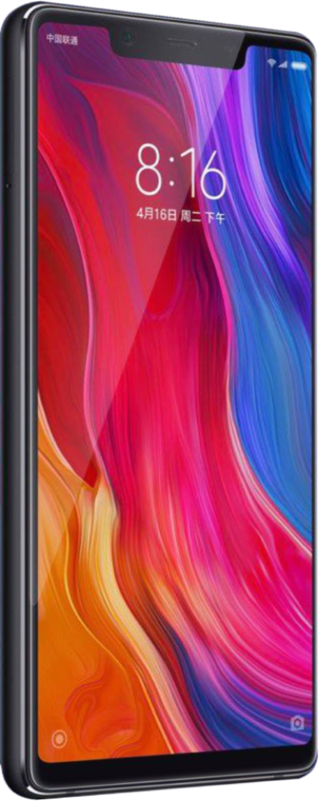
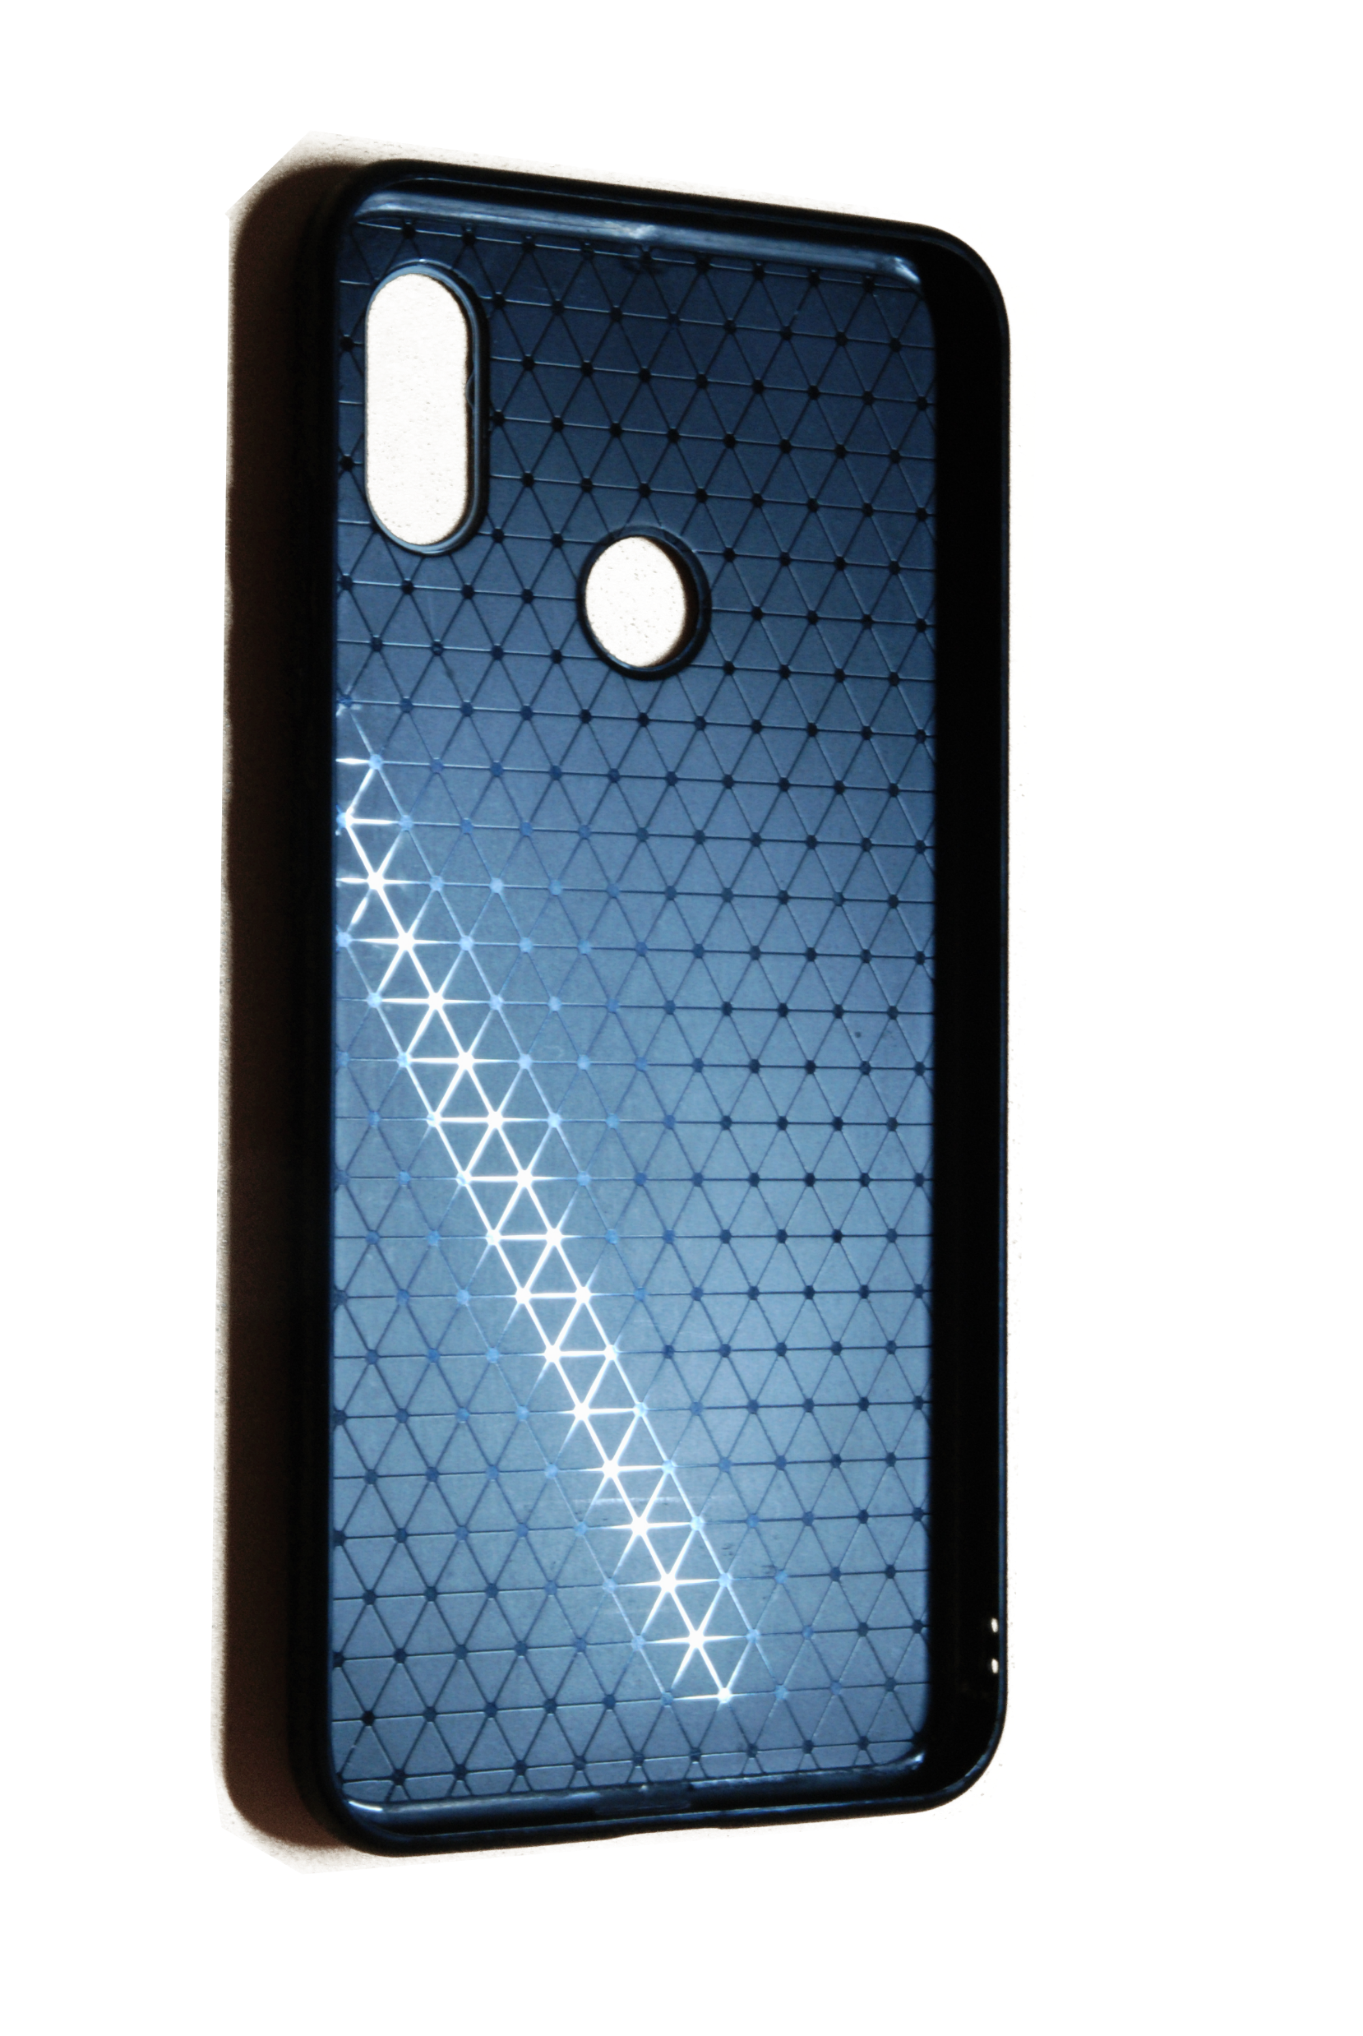
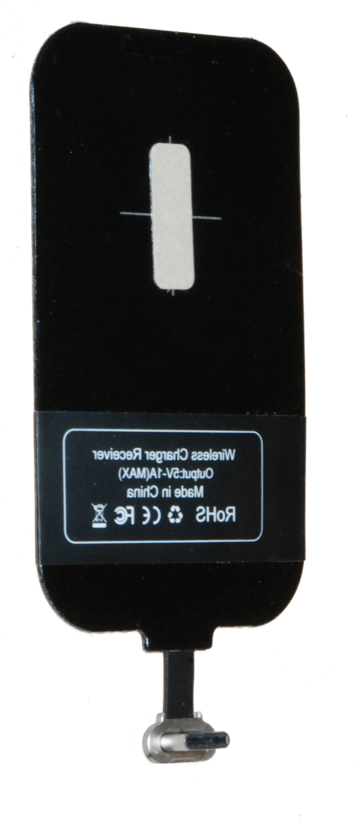

$5-$10
Simple
Accessible
Cheap
Simple
Accessible
Cheap
$2-$3
Notes:
Leo: Product detail
Leo: price
Parv: Painting the case

Slide 11

Notes:
Safety and benifit

Slide 14
Credits
Leo Chai
Salah Abboushi
Ahmed
Reyyan
Parv Tuli

